Slide 1
Collisionless Weibel shocks and electron acceleration in gamma-ray bursts
Kazem Ardaneh, Dongsheng Cai CAVE Lab, Department of CS, University of Tsukuba, Japan
Ken-Ichi Nishikawa Department of Physics, University of Alabama in Huntsville, USA
and Bertrand Lembege LATMOS, UVSQ, France

Slide 2
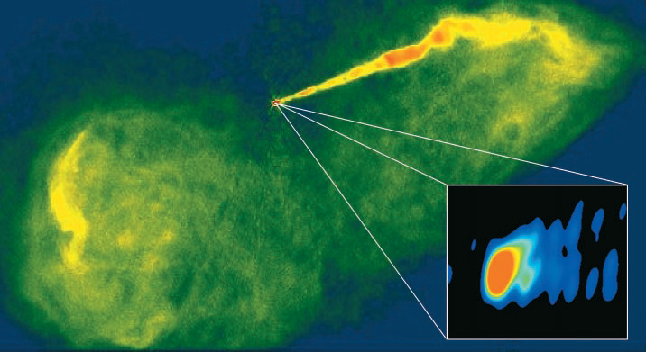
Motivations
High energy astrophysics phenomenon involve interactions of relativistic jet (bulk γ >> 1) plasma with ambient plasma:
GRBs: Colliding plasma shells (internal shocks), external double shocks
AGN jets: Bow-shocks
The jet in the galaxy M87
Biretta and Junor,
Nature (1999)

Slide 3
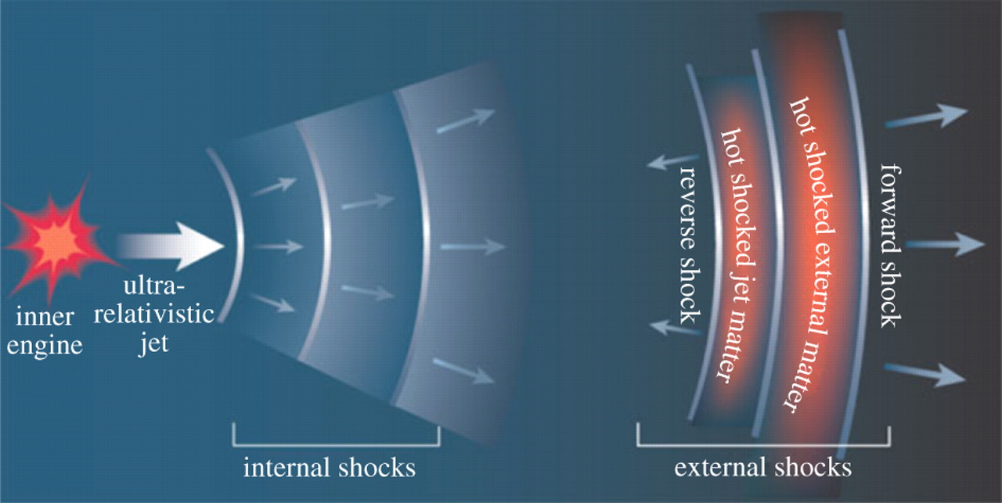
Astrophysical shocks
Astrophysical shocks are collisionless (mean free path >> system size)
Shocks span a range of parameters:
Non-relativistic to relativistic flows (Solar Wind < Jets < GRB < PWN)
Magnetization (magnetic/kinetic energy ratio: GRB< Jets< Solar Wind)
Composition (pairs: e-ions / pairs: e-e+)
Astrophysical collisonless shocks can:
1. Amplify magnetic fields
2. Exchange energy between species
3. Accelerate particles
4. Highly non-thermal radiation

Slide 4
Relativistic shock Particle-in-cell research
Dimension
Composition |  | 1D | 2D | 3D
 | e-e+ | Hoshino, ApJ (2002) SSA under MSW | Spitkovsky, ApJ (2008), DSA | Nishikawa et al, ApJ (2009), No acceleration study
 | e-ion | Hoshino, ApJ (2002) SSA under ESW | Amano and Hoshino, ApJ (2009), SSA under ESW Martins et al, ApJ (2009), DSA Guo et al, ApJ (2014), SDA | Hededal et al, ApJ (2004), Electron heating by E×B Weibel fields
No discussion about particle acceleration in 3D full shock configuration
SSA: Sock surfing acceleration
MSW: Magnetic solitary wave
ESW: Electrostatic solitary wave
DSA: diffusive shock acceleration
SDA:
Sock drift acceleration

Slide 5
What changed?
Advances in computer hardware and better algorithms have enabled running large enough simulations to resolve shock formation, and particle acceleration,
The code: Relativistic 3D EM TRISTAN,
Parallelized by MPI,
Optimized for large-scale simulations,
Appropriate boundary conditions for shock generation,
Proper diagnostics for particle acceleration analysis,
Buneman (1993)
Niemiec et al. (2008)
Noise reduction of the curl operator in FDTD | Filtering implementation
Attenuate the numerical Cerenkov radiation Greenwood et al. (2004)

Slide 6
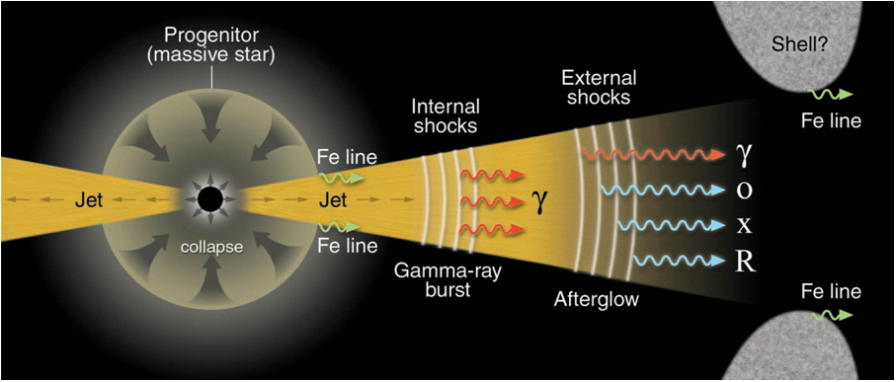
Issues and Questions
Meszaros, Science (2001)
Simulation box
What are the field structures responsible for the processes of electron heating, and acceleration?
Where do these processes mainly take place?
What is the resulting associated electron energy spectrum?
What are the principal mechanisms responsible for electron heating, and acceleration?

Slide 7
Problem setup
Parameters | Run 1 | Run 2
Grid | (1025,165,165) | (8005,245,245)
ppc (ambient) | 12 | 6
Jet density ratio | 0.715 | 1.7
Injection speed | γ = 5 | γ = 10
Mass ratio | 20 | 16
λce | 5Δ | 5Δ
Δtωpe | 0.025 | 0.01
Stiff reflecting boundary for the ambient particles in x-direction,
Open boundary condition for jet particles in x-direction,
Periodic boundary condition at all other boundaries

Slide 8
Two-stream instability
Electrostatic Buneman instability
Electromagnetic Weibel instability
Filamentation of plasma
Buneman (1958)
Weibel (1959)
Moiseev & Sagdeev (1963)
Medvedev & Loeb (1999)
Spatial scale:
Time scale:

Slide 9
Weibel instability (Run 1)
Electron Weibel instability
Ion Weibel instability
Debye shielding by electron
Electron heating / acceleration
Ardaneh et al, NeW A.(2014)
Ardaneh et al, New A.(2014)
$$t^{∗}=144$$
$$y^{∗}=16.5$$

Slide 10
Double shock structure & validation (Run 2)
Ardaneh et al, ApJ.(2015)
PIC:
PIC:
RS:
FS:
Theory:
Theory:
CD:
PIC:
Theory:

Slide 11
Double shock structure (Run 2)
Ardaneh et al, ApJ.(2015)
Filamentary currents
Transversal EM fields,
Stronger fields in the RS,
Transverse size of several electron Larmor radii
Ex (electrostatic field) due to the density gradient and different mobilities
of charges

Slide 12
Particle distribution (Run 2)
Ardaneh et al, ApJ.(2015)
Fully thermalized electrons
Jet electrons trapping by the Ex
Effectively acceleration by Ey, and Ez
High-energy electron reflection by By, and Bz in the shocked region
Slowing down Ex
Transferring the jet kinetic energy to the heating of ambient particles
Fully thermalization has not occurred for ions

Slide 13
Electron spectrum (Run 2)
Ardaneh et al, ApJ.(2015)
Electrons are heated by γ=100
Electrons are accelerated by γ=360 with a power-law regime

Slide 14
Particle acceleration (DSA)
First order Fermi acceleration
(Krymsky 1977, Bell 1978, Blandford & Ostriker 78)
Efficient scattering of particles is required.
Particles diffuse around the shock.
2D PIC simulation:
Spitkovsky, ApJ (2008), Martins et al, ApJ (2009)

Slide 15
Electron heating (Run 2)
Ion Weibel instability,
Ion current filamets,
Ardaneh et al, ApJ.(2015)

Slide 16
Particle acceleration (SSA)
Sagdeev & Shapiro 1974,
Zank et al. 1996,
Lee et al. 1996
Ardaneh et al, ApJ.(2015)
SSA for ions
SSA for electrons
SSA for electron under ESWs:
1D PIC simulations by Hoshino (2001); Hoshino & Shimada (2002)
2D PIC simulations by Amano & Hoshino (2009); Matsumoto et al. (2012)

Slide 17
SSA for electron (Run 2)
Ardaneh et al, ApJ.(2015)
Trapping behind the RS
Acceleration by Ey and Ez Weible fields
Drift in YZ plane

Slide 18
Conclusions
Ion Weibel : sources of EM fields,
Most accelerated electron are located in the RS transition region,
Electron spectrum in the RS transition region include non-thermal electrons with power-law index 2.2,
Electrons are heated up to the γ = 100 due to the E×B drift ,
Electron are accelerated via SSA process in RS transition region.

Slide 19
Thank you

